Slide 1
SBA- Azure Fundamentals Final Project
Germila Saint-Jean.- 02/09/2025

Slide 2

Introduction
I am an IT professional with a Bachelor's degree in Computer Science and Entrepreneurship, experienced in software development and project management. I hold a CompTIA A+ certification and graduated in IT Support from Per Scholas. I have worked as an IT Help Desk at PCA Companies and as a Technical Support Engineer II at Tek Experts. I am passionate about networking, learning new things, and sharing my expertise, and I am focused on advancing my career.

Slide 3
Project Overview
Background / Scenario-
AZFK-Tech, a newly founded business, has asked you, a contractor, to help them build up their cloud infrastructure. But before you can install your infrastructure in their production environment, you must first demonstrate your ability to do so in a virtual lab environment. Note that Azure only allows 3 public IPs per region.
Objectives-
Using the skills learned throughout the course, complete the following Skills-Based assessment (SBA).
Part 1: Set up Department Group Resources.
Part 2: Set up the VNets for each department.
Part 3: Set up VMs for each department.
Part 4: Create and Apply Security Group Policies to each department.
Part 5: Set up a Database.
Part 6: Set up a Web App for the Marketing and Sales (MAS) department.
Part 7: Deploy a shared storage between all departments.
Part 8: Deploy Monitoring resources.
Part 9: Questions.
Part 10: Presentation/Submission.

Slide 4
Azure Fundamentals: Key services and concepts
Azure is Microsoft's cloud platform, providing a variety of services such as computing, analytics, storage, and networking.
Key services:
Compute: VMs, App Services, AKS
Storage: Blob, File, Disk
Networking: VNet, Load Balancer, VPN Gateway
Database: SQL Database, Cosmos DB, MySQL/PostgreSQL
Identity: Active Directory, AD B2C
Compute services:
Cloud Computing Models: IaaS, PaaS, SaaS
Architecture: Regions, Availability Zones, Resource Groups
Management: ARM, Azure Policy, Azure Monitor
Security: Security Center, Key Vault

Slide 5
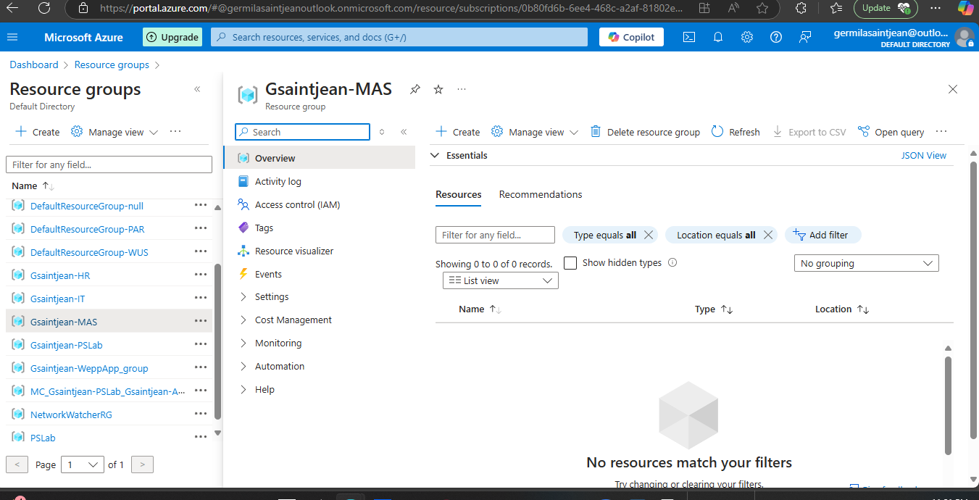
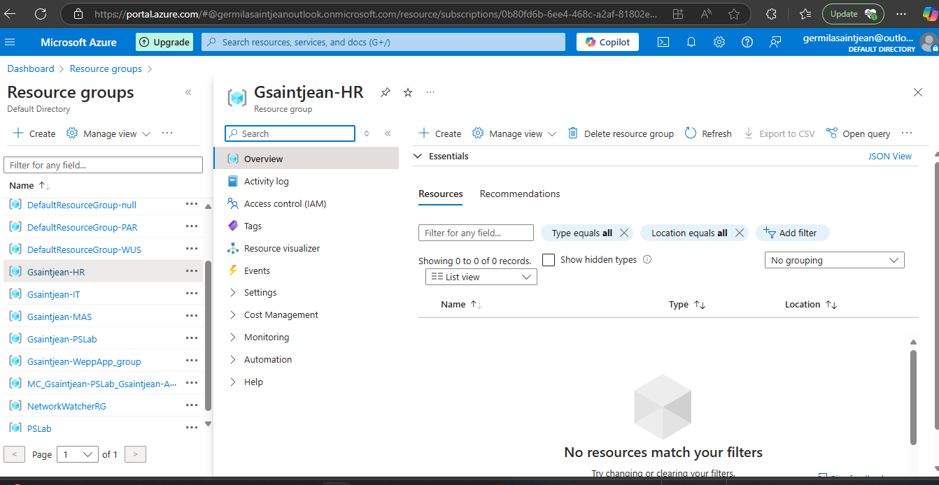
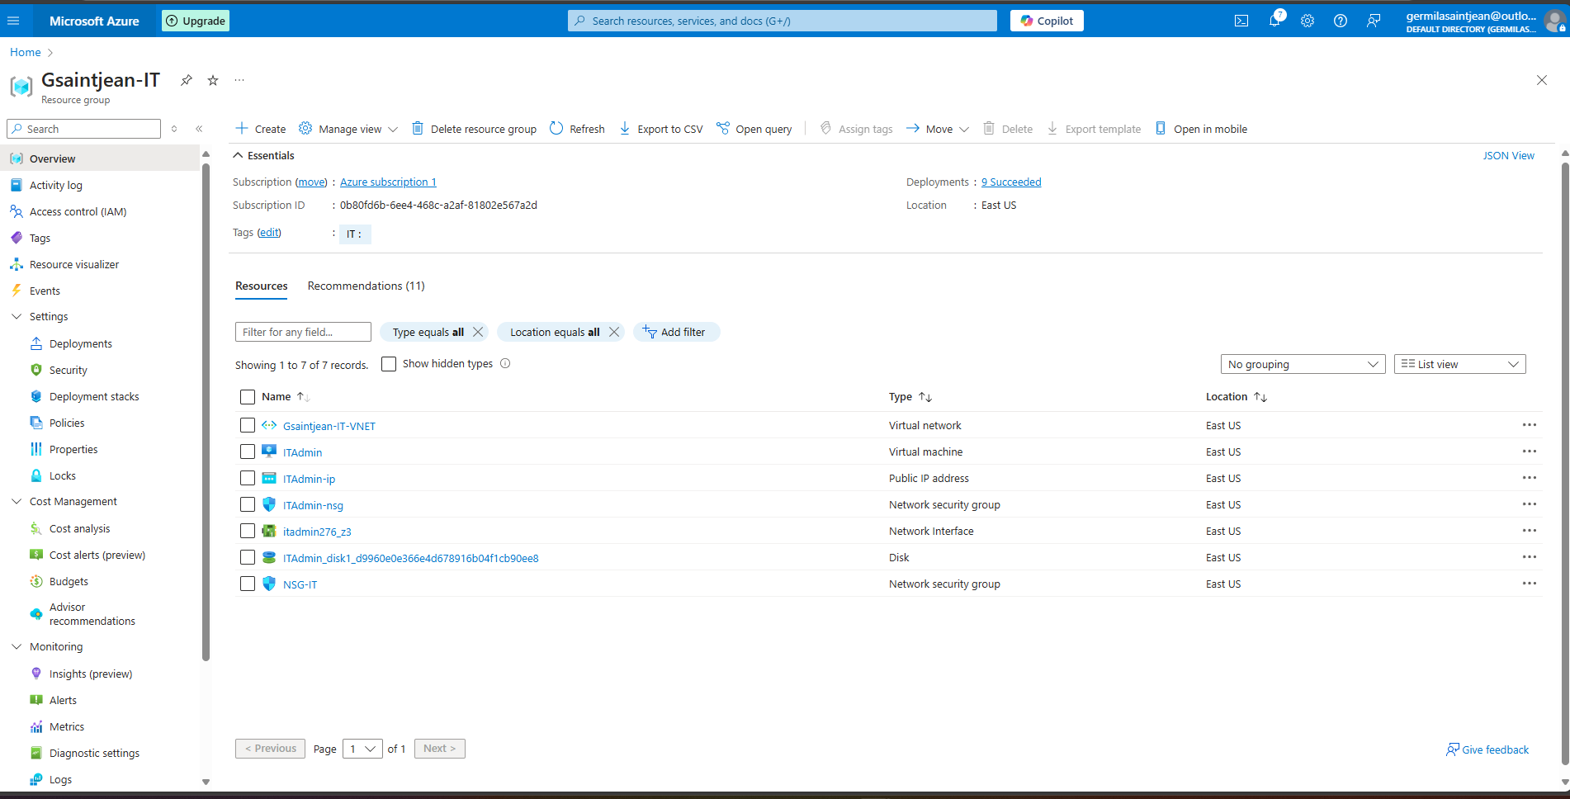
Implementation
Set up Department Group Resources: MAS-HR-IT

Slide 6
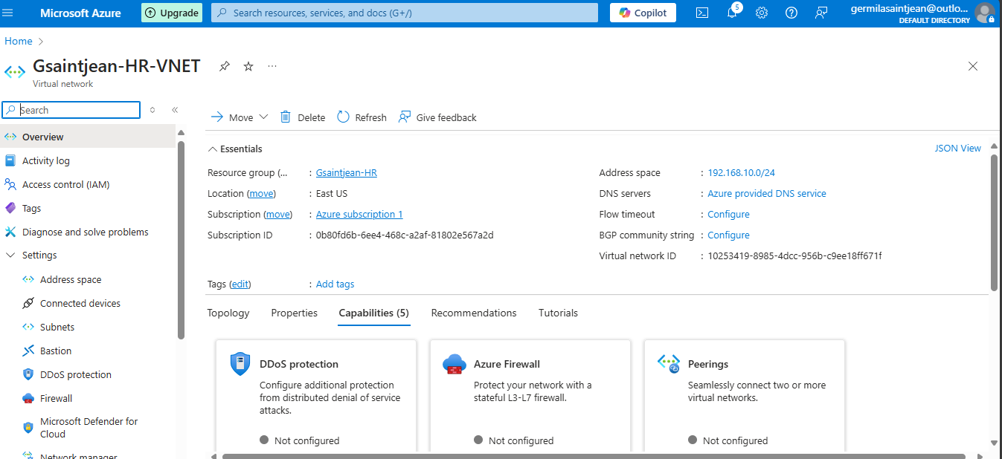
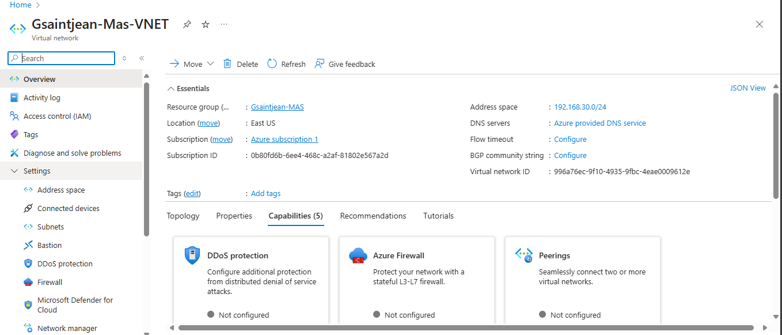
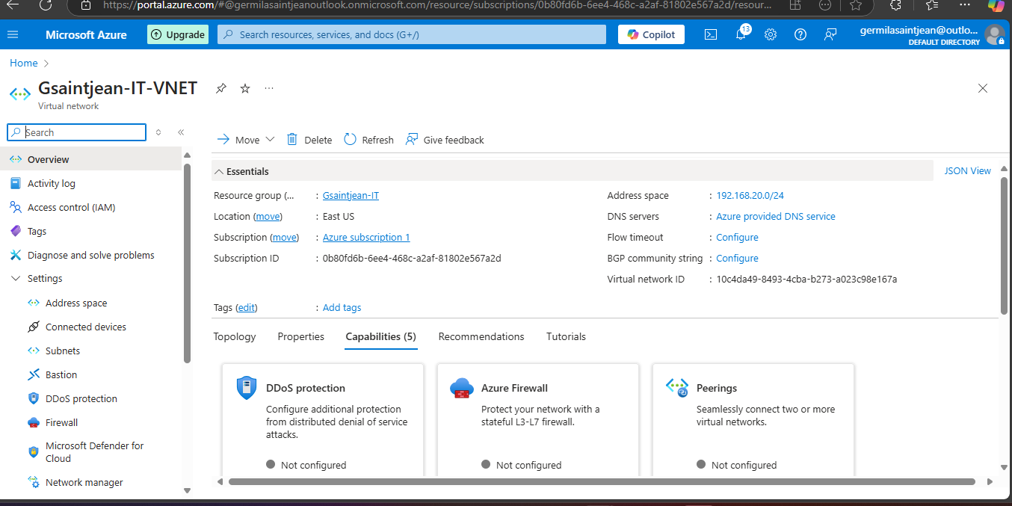
Implementation
Set up VNets for each department

Slide 7
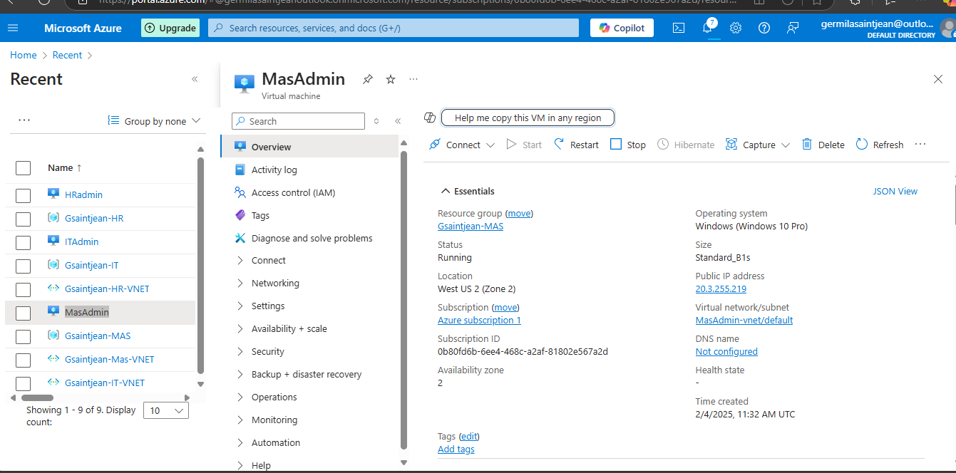
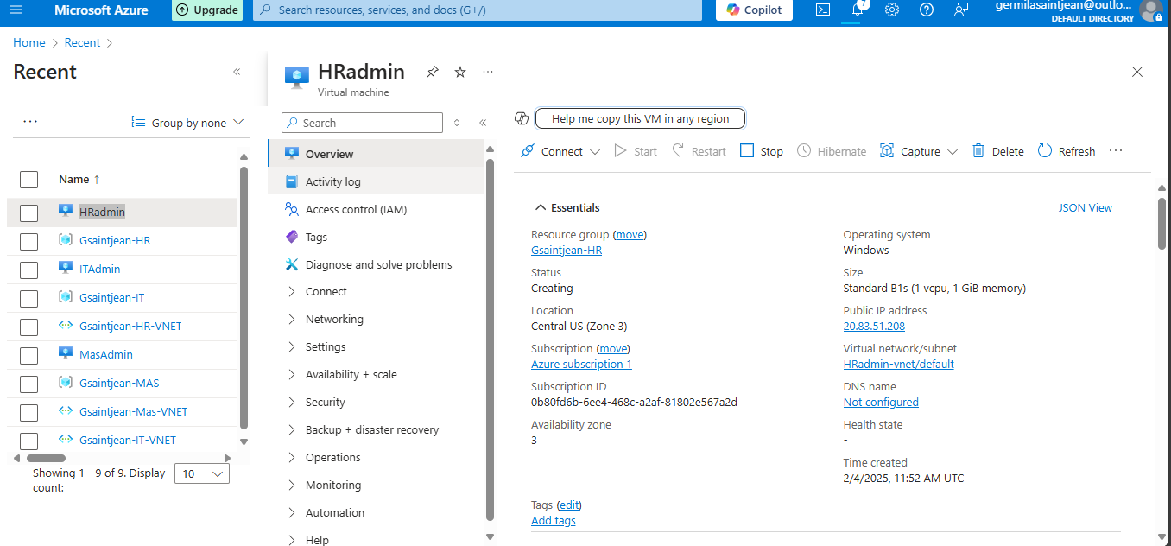
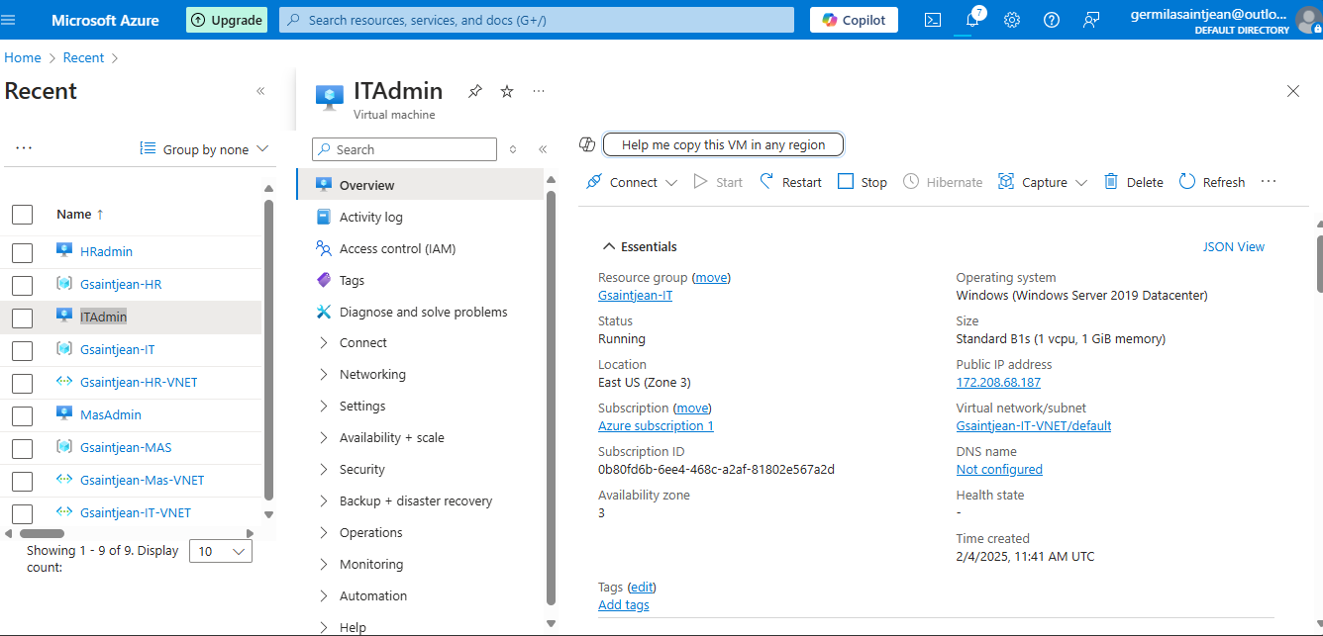
Implementation
Set up VMs for each department

Slide 8
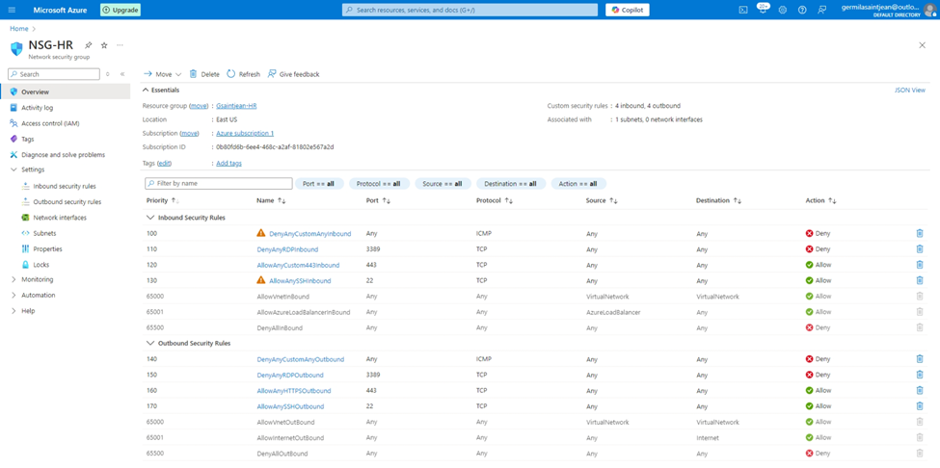
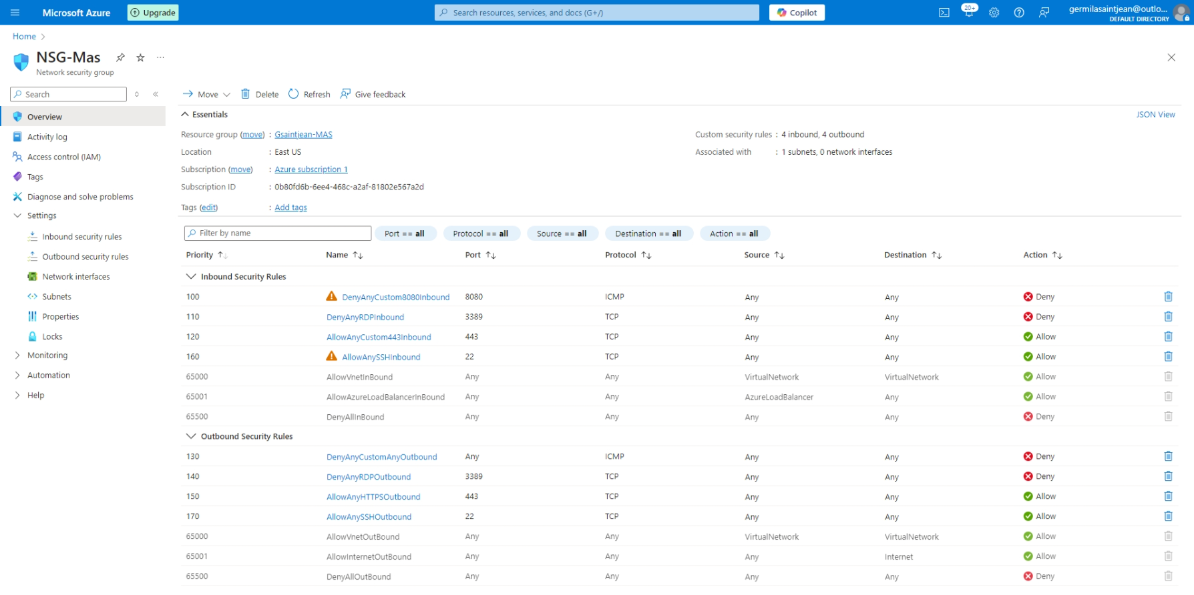
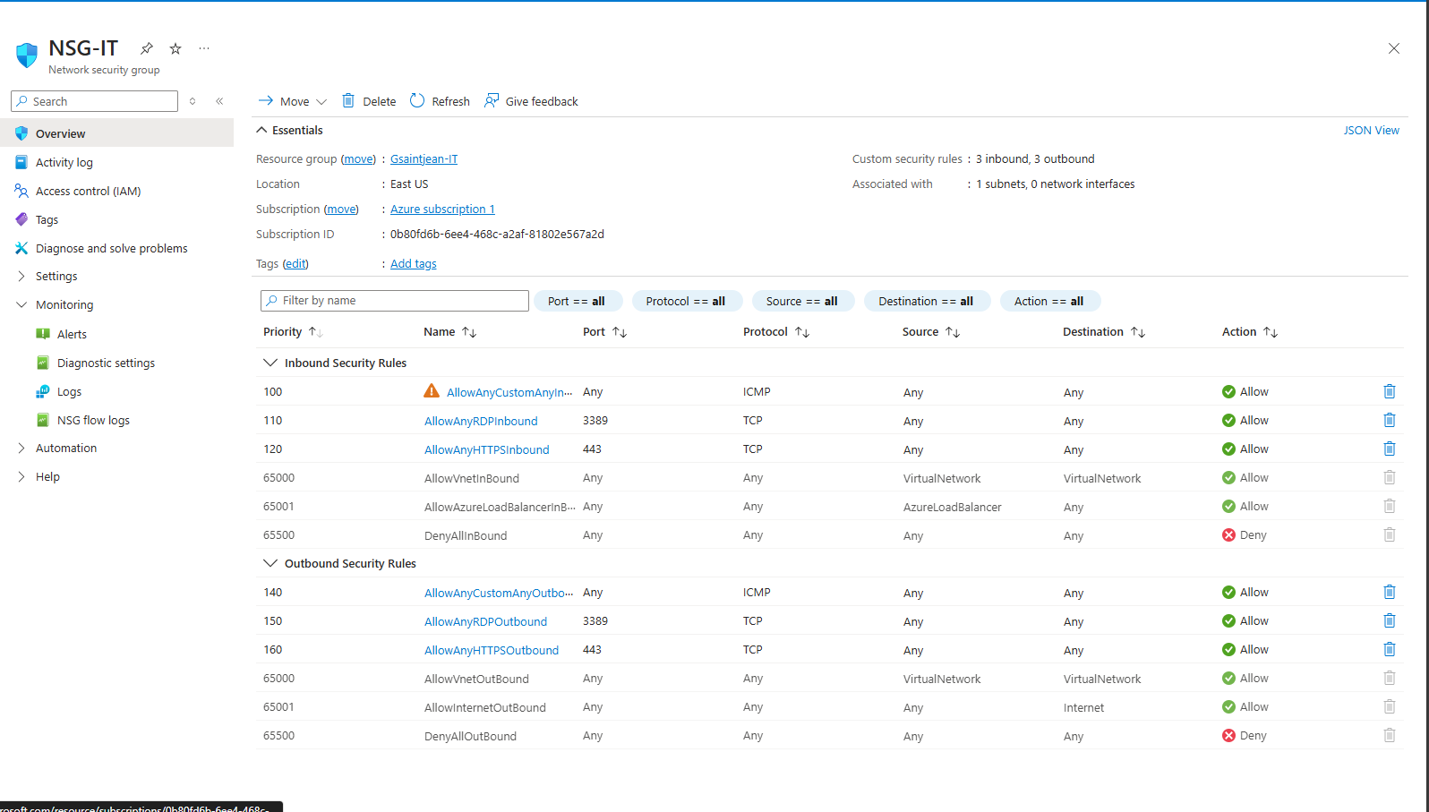
Implementation
Create and Apply Security Group Policies to each department

Slide 9
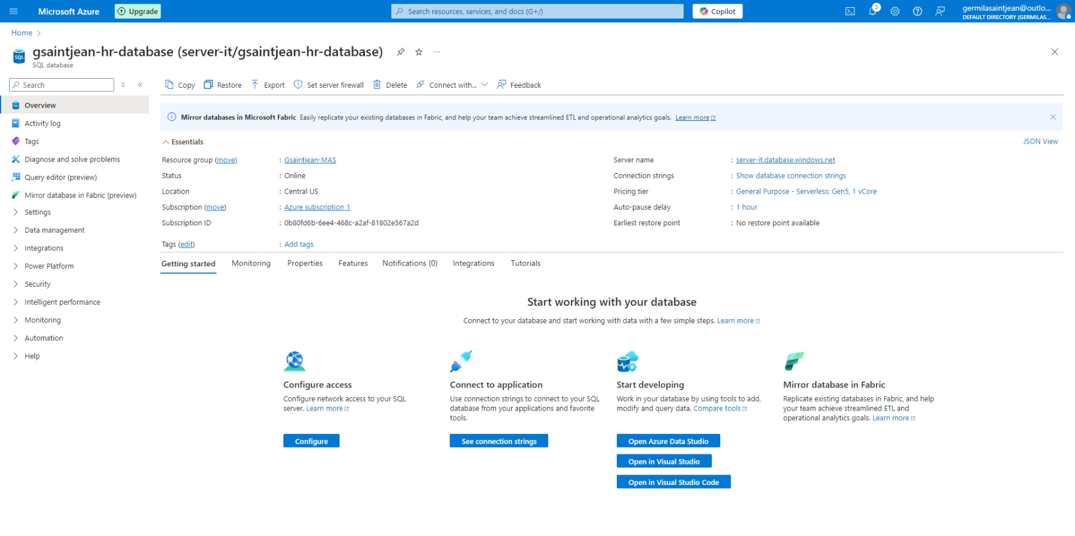
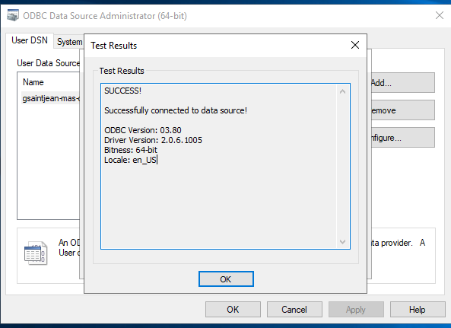

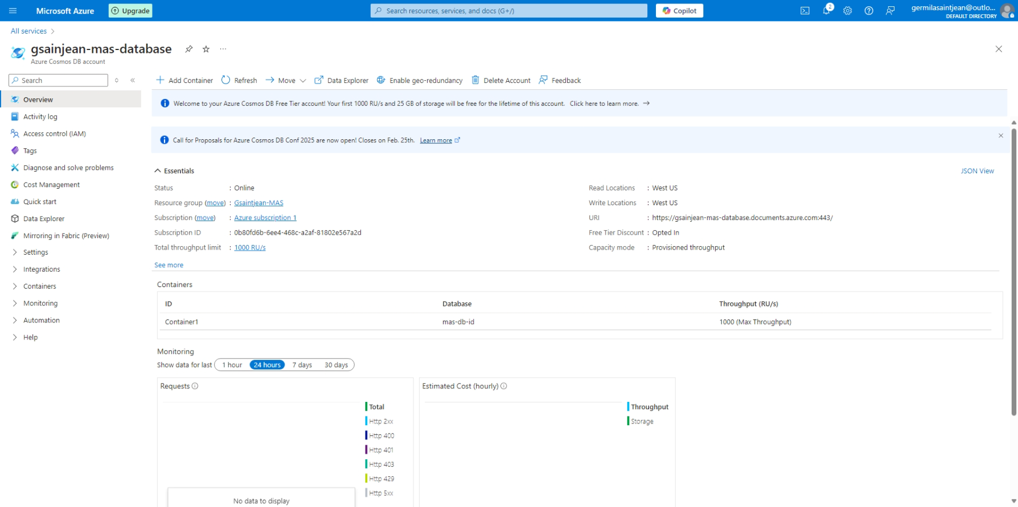
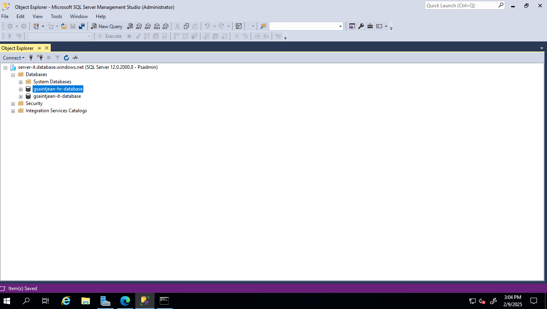
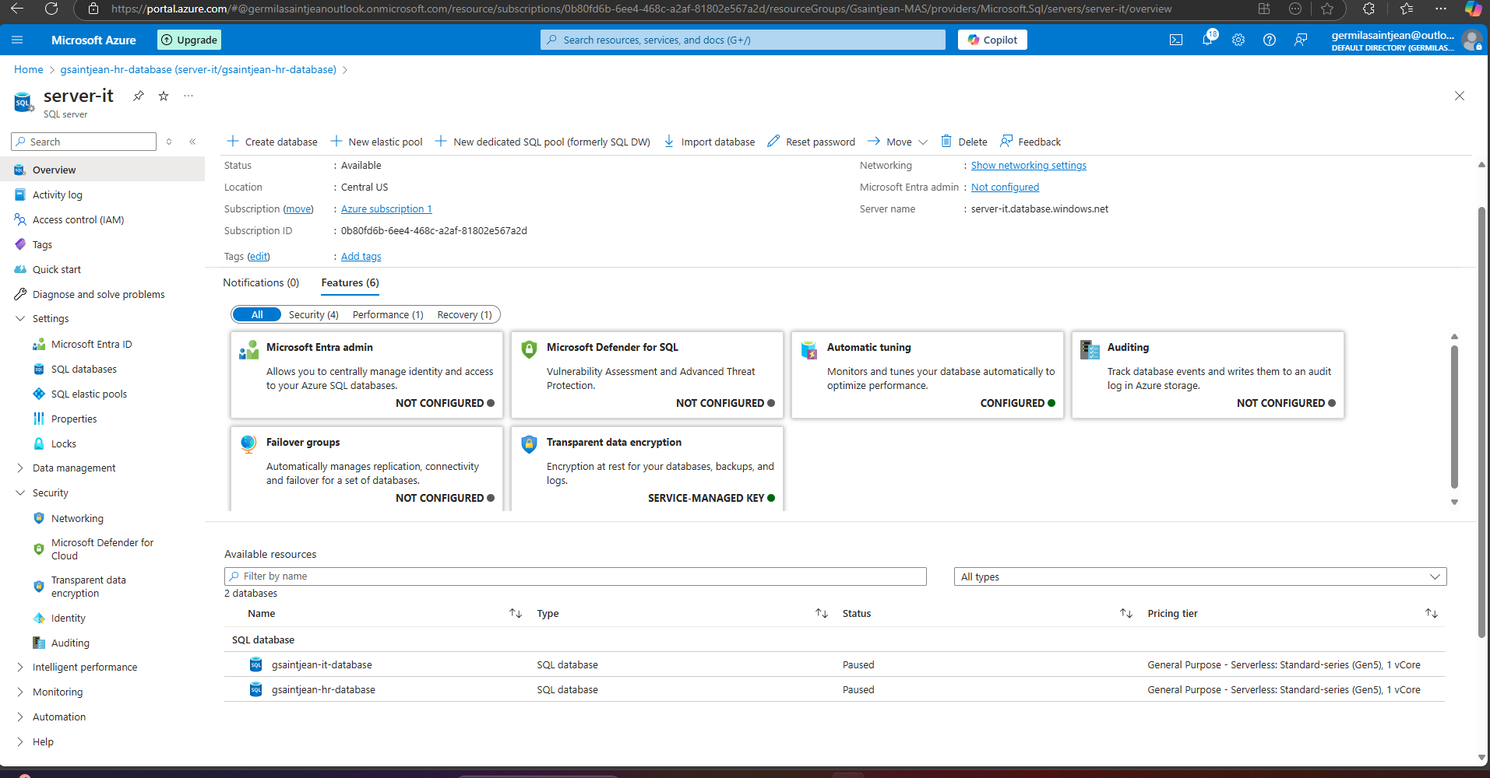
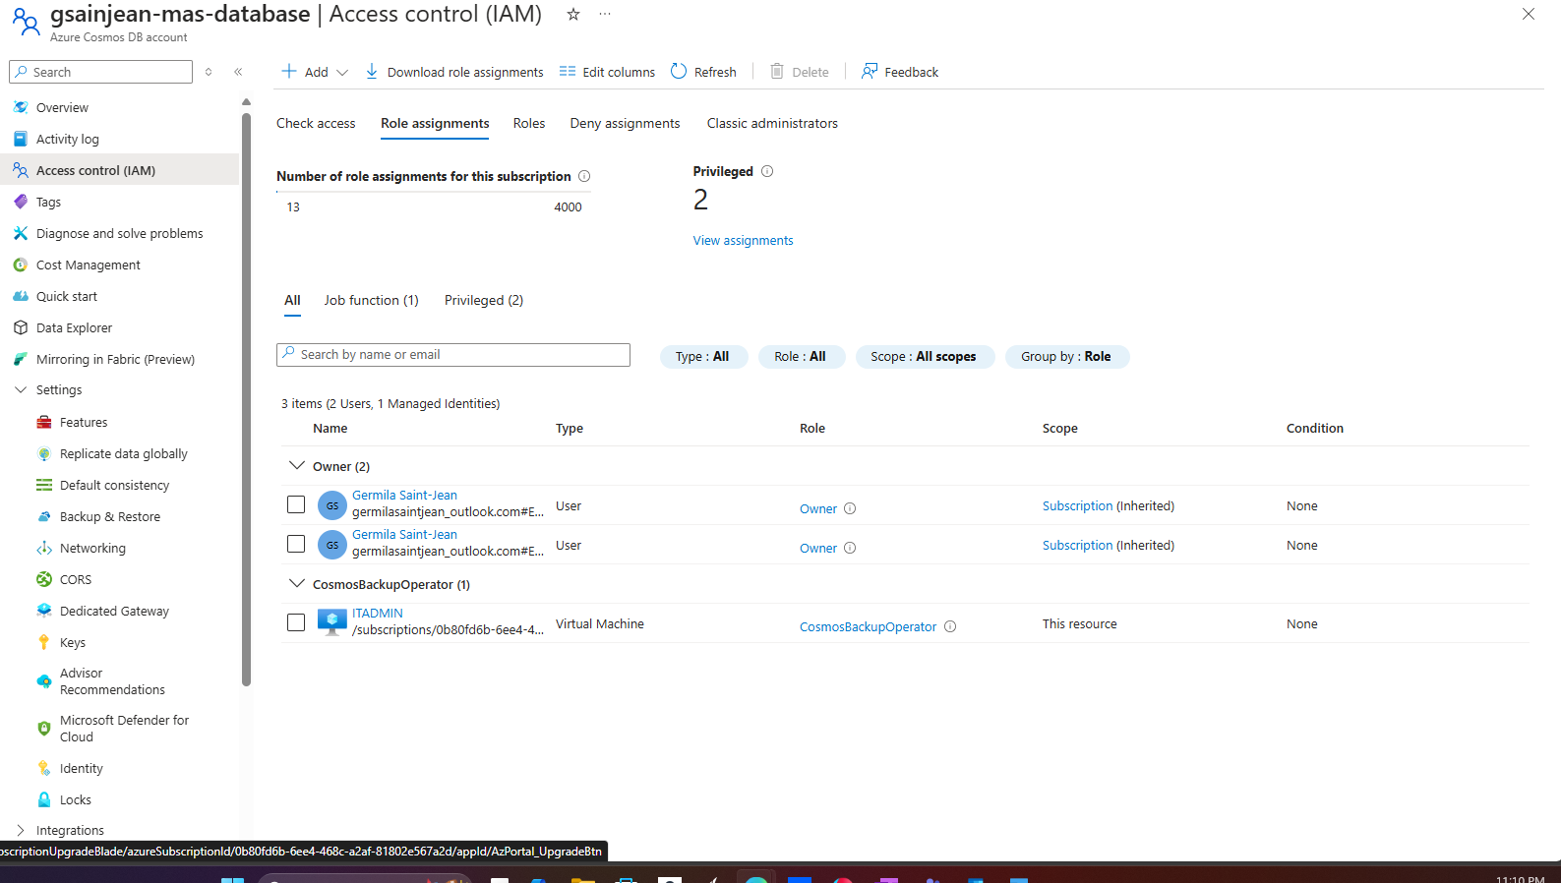
Impementation
Set up Database

Slide 10
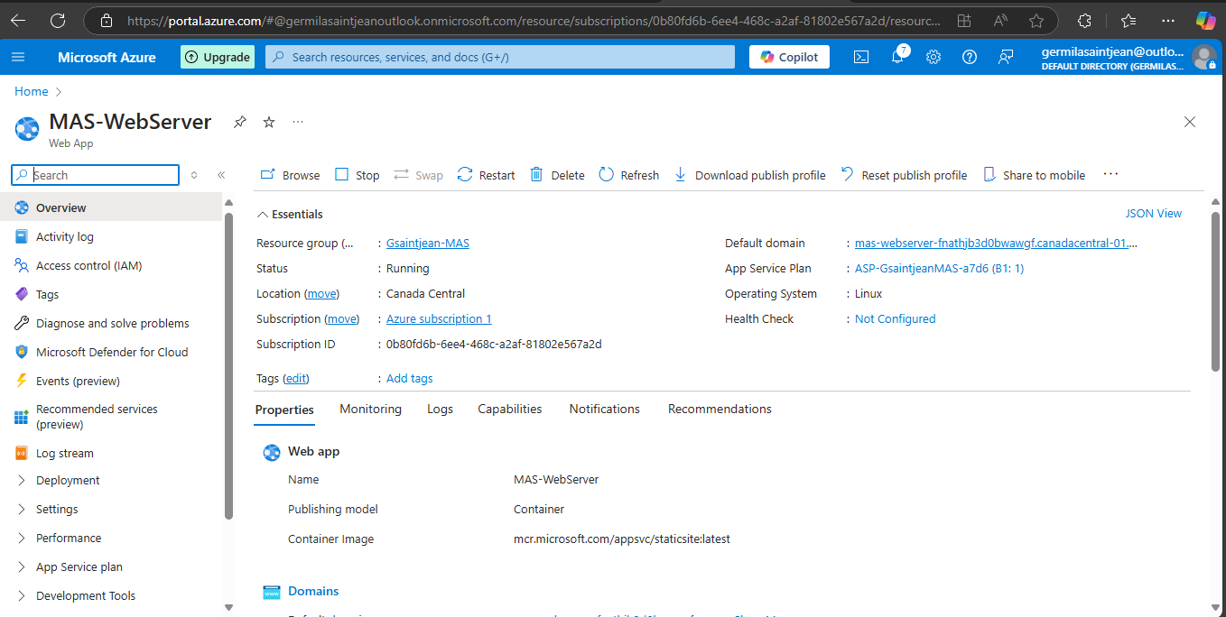
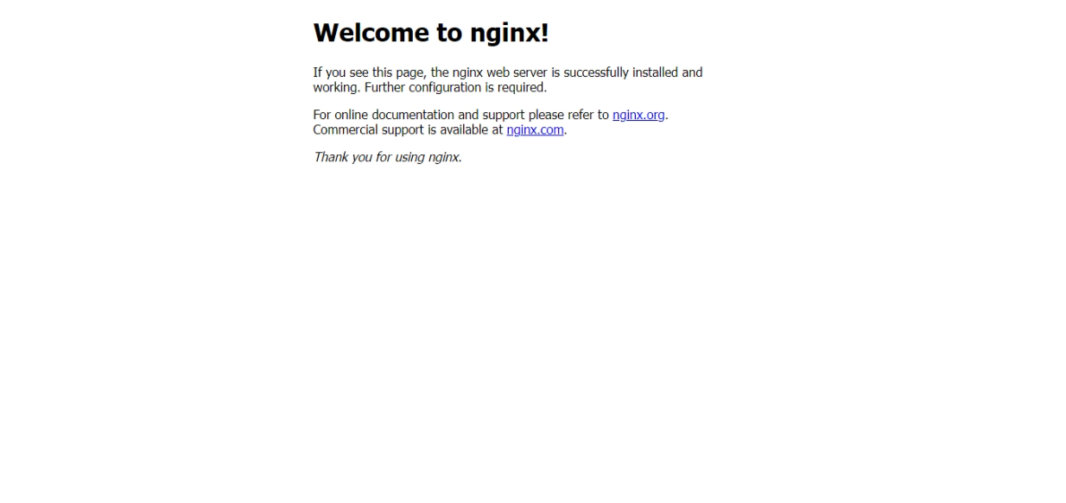
Implementation
Set up a web App for the marketing and Sales (MAS) department

Slide 11
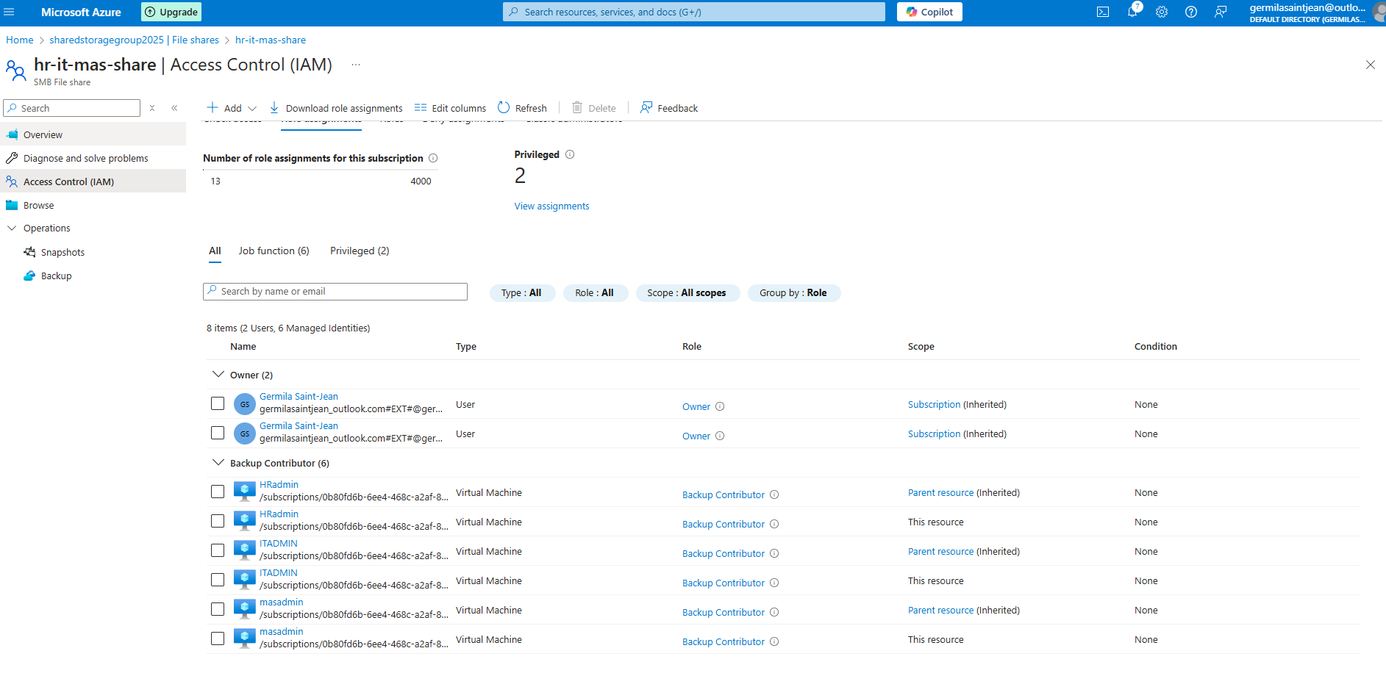
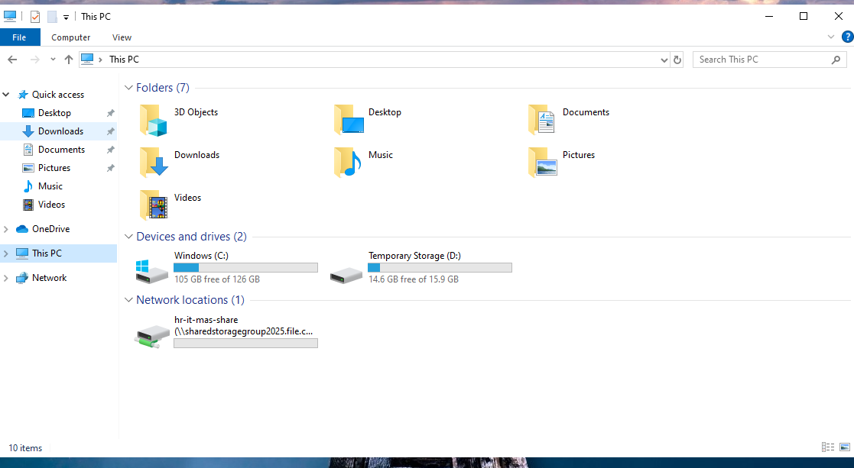
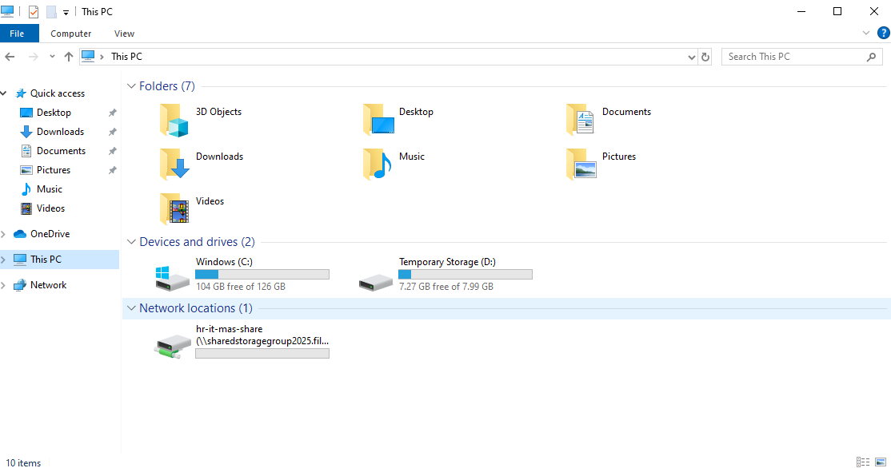
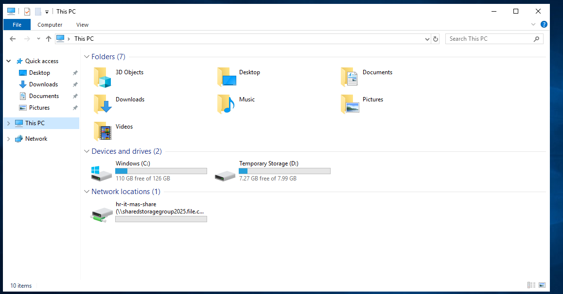
Implementation
Deploy a shared storage between all departements

Slide 12
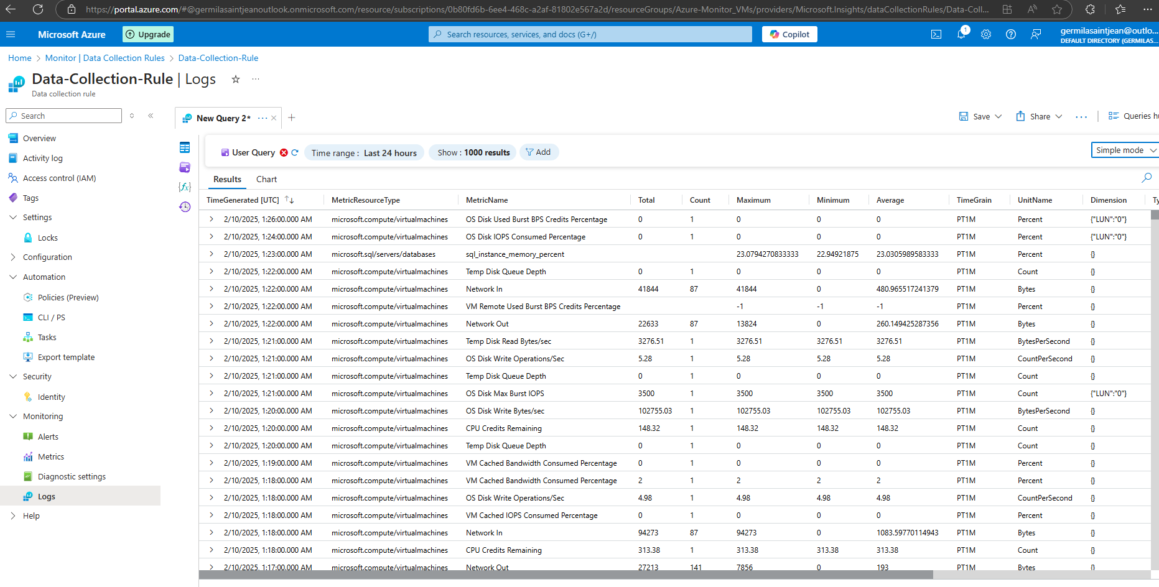
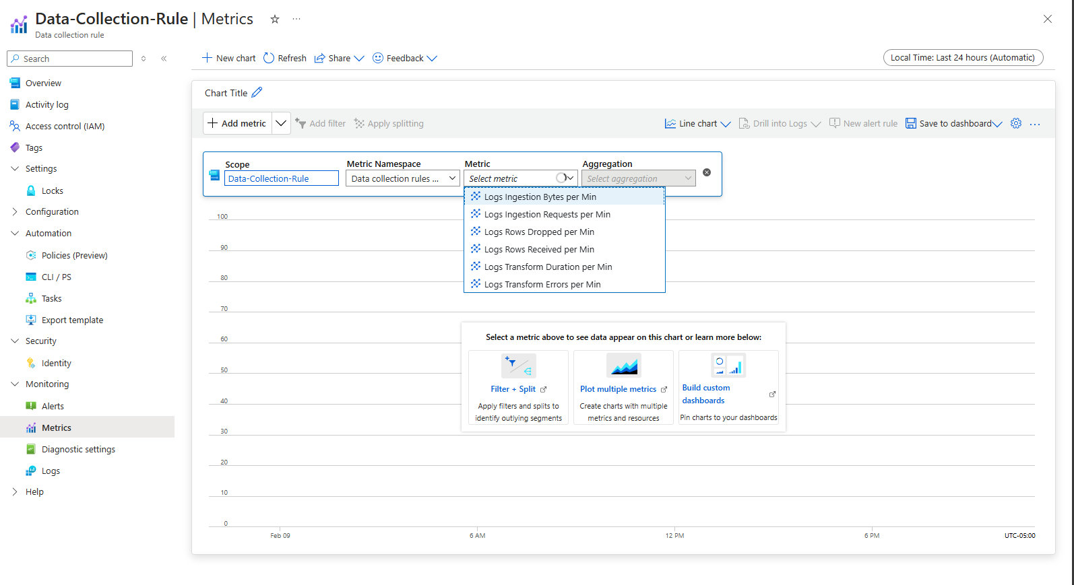
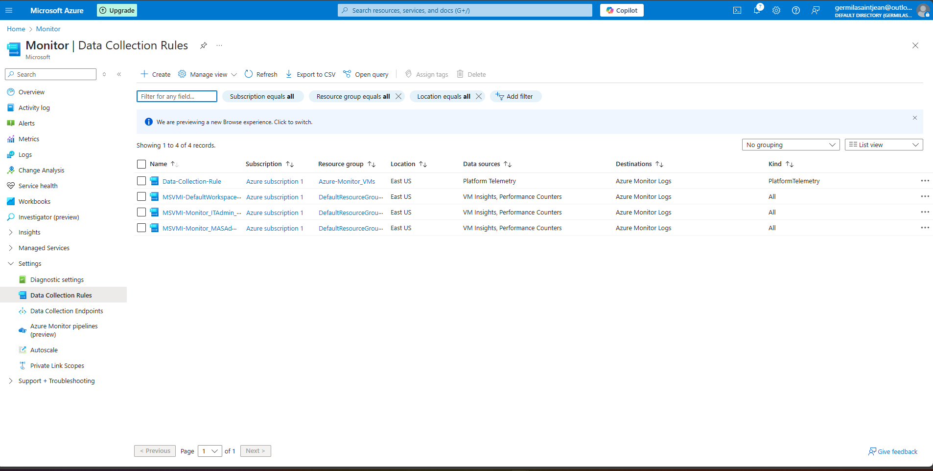
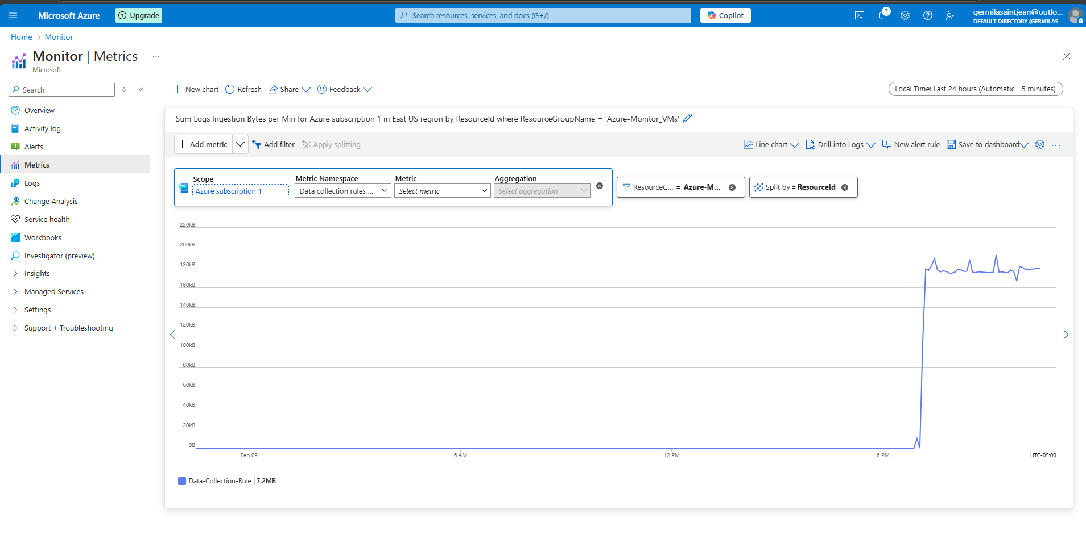
Implementation
Deploy Monitoring resources

Slide 13
Challenge and Solutions
One of my first challenge was after deploying my IT-VM. It took me a while to figure out how to access HR-DB and MAS-DB because I didn’t have enough space in my IT-VM. Whenever I tried to connect, the screen would freeze. I reconnected to my Azure portal, resized my CPU and RAM, and the VM finally ran properly.
Setting up firewalls for each department was another challenge. I did a lot of research to figure out the ports that should not be able to ping any department.
Creating databases for each department was also challenging. Every time I chose a region; I failed until I tried several regions and was successful. I created an Azure Cosmos SQL database for the MAS department and SQL databases for both HR and IT. I did a lot of research to find out which tools to use to access the different databases. I finally discovered that SQL Server Management Studio is suitable for SQL databases and Open Database Connectivity (ODBC) drivers for Azure Cosmos DB.
Another challenge was accessing my file share in my VMs because I had entered the wrong path. After some research, I found the correct path.

Slide 14
Results and Benefits
I feel more comfortable deploying infrastructure in the Azure cloud.
The challenges and errors I encountered taught me a lot as I was able to fix them.
I now have a better understanding of the concepts and services.
My research led me to discover a lot of helpful documentation.
Previous labs and my notes were instrumental in deploying this project.
By reviewing my previous labs, I realized there were things I didn't understand well.
Now, I feel ready to focus on my Azure exam, as I have a better grasp of the concepts and services

Slide 15

Conclusion and Final thoughts
I appreciate everyone's time

